Slide 1
RFM analysis- Online Retail Sales Data
Submitted By:
Krishna Goswami
Tanmay Arora

Slide 2
Agenda
Business Objectives
Data Preparation
Analysis
Models
Insights

Slide 3
Business Objectives
Analyze Sales Transaction Data of a online retail company using RFM analysis method.
RFM ( recency, frequency, monetary) analysis is a marketing and customer segmentation technique that uses past purchase behavior to divide customers into groups .
RECENCY (R): Time since last purchase FREQUENCY (F): Total number of purchases MONETARY VALUE (M): Total monetary value
Provide recommendation/insights based on analyze to improve revenue and reduce customer attrition

Slide 4
Data Understanding

Slide 5
Brief about the dataset
The dataset contains Sales Transaction Data from Dec’2010 till Dec’2011
There are ~400000 transaction records of ~4300 customers in the dataset.
Following fields are available in the dataset:
InvoiceNo: Invoice# of the transaction
StockCode: Unique Product Code
Quantity: No of products in the transaction
DoP: Date of Purchase
UnitPrice: Unit Price of the product
CustomerID: Unique Customer Id
Country: The Country from where the transaction took place
Date format is not consistent in DoP column, need to be corrected during data preparation.

Slide 6
Data Preparation

Slide 7
Data Cleaning and Assumption
Date format is not consistent in DoP column, it has been corrected before analysis.
There are 1920 (<1%) records whose StockCode are 'POST', 'D', 'BANK CHARGES', 'C2', 'CRUK', 'DOT', 'M', 'PADS‘. They are deleted before doing the analysis.
There are 8359 records whose Quantity is <0. They are considered as returned items.

Slide 8
Main Data Marts/Tables
Created RFMDM table for the sales transaction records containing following main columns:
Invoice No, StockCode, Quantity, DoP, UnitPrice, CustomerID, Revenue, TM_ID
TM_ID contains data in year_month format .e.g 2011_12, 2011_10 etc.
Created RFMSEGMENTATION table for storing below information grouped by CustomerID from RFMDM table
CustomerID, Recency, Frequency, Products, Tenure, Monetary

Slide 9
Data Analysis

Slide 10
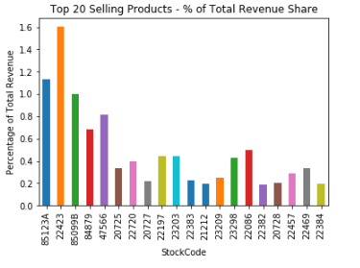
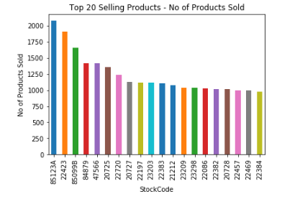
Products Performance Analysis
Find Top 20 selling products by quantity

Slide 11
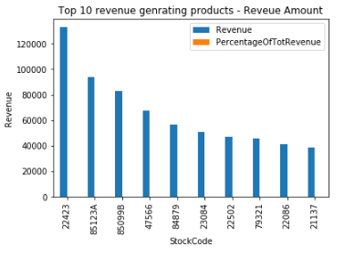
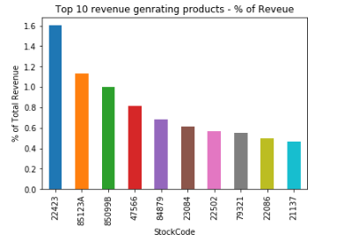
Contribution Analysis (Products)
Find revenue generating products in the top 10% slab
There are total 368 products contributing to the 10% of the overall revenue
Top 10 revenue generating products and their contribution is :

Slide 12
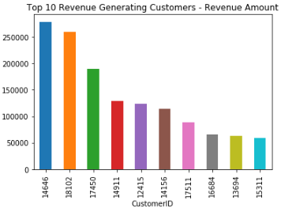
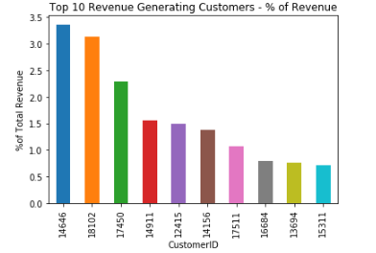
Contribution Analysis (Customers)
Top 10 revenue generating customers and their contribution is :

Slide 13
Customer Base Analysis
It is covered as part of Customer segmentation in the next slides

Slide 14
Modeling

Slide 15
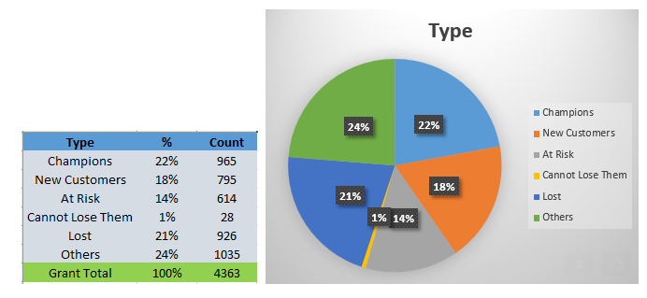
Customer Segmentation
Customers are divided into multiple segments based on their RFM scoring (ratings are given from 1 to 5, 1 being lowest and 5 being highest)

Slide 16
Product Affinity Model Building
Product Affinity model has been built using apriori algorithm.
Top 10 association rules using lift metric is given for reference:
Sl No | Product1 | Product2
1 | 20725 | 20727
2 | 20727 | 20725
3 | 20725 | 22383
4 | 20383 | 20725
5 | 20725 | 85099B
6 | 85099B | 20725
7 | 20727 | 22383
8 | 22383 | 20727
9 | 23203 | 85099B
10 | 85099B | 23203

Slide 17
Predict Repeat Customer
As part of training data set, Sales records from Jan’11 till Mar’11 are taken and applied the below rule to check % of repeat customers in Apr’11. % of repeat customers came to around 85%.
Rule is: Check the customers whose Recency rating is between 4 and 5 and Frequency rating is 5.
As part of test data set, Sales records from May’11 till July’11 are taken and applied the same above rule to check % of repeat customers in Aug’11. % of repeat customer came to around 85%.
Hence the rule is valid for both training and test data set.

Slide 18
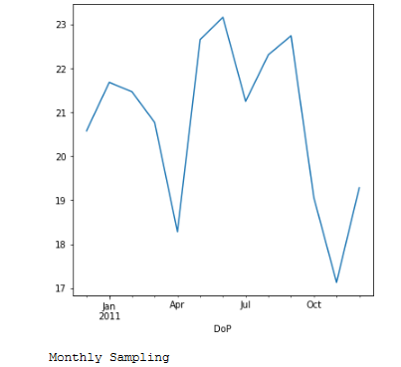
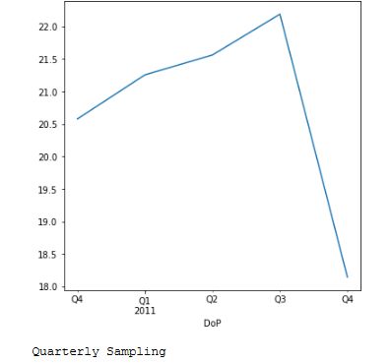
Sales Forecasting
Time series data was sampled Monthly and Quarterly basis and it is noticed that in 4th Quarter’2011, there is sudden dip in revenue.
On further analysis by running sql queries, it is found that there are many returns in Oct’11 and Nov’11 and this has caused decrease in revenue.

Slide 19
Insights

Slide 20
Recommendations
Company can change their marketing strategies based on customer segmentation and increase their profitability and reduce customer attrition
Company need to check why there is large number of returns in the month of Oct’11 and Nov’11, which is causing revenue loss in the last quarter of 2011.
Company can focus more on top revenue generating and top selling products to increase revenue.

Slide 21
GitHub Reference
The project is developed using Python and the python code file is available in GitHub in the following location:
https://github.com/kgopal1982/Analytics/blob/master/RFMAssessment/RFMAnalysisAssessment.ipynb

Slide 22
Thank You

